Slide 1
Applied Gamma Spectroscopy using InterSpec
UUR SAND2021-2864 TR
Will Johnson
wcjohns@sandia.gov, InterSpec@sandia.gov

Slide 2
Outline
What to expect
Physics review
Basics of using InterSpec to look at data
Nuclide ID
Fitting for activity and shielding
We will work “Example 1.n42”
Energy calibration
Other tools in InterSpec, and useful information
A few more example problems
Questions

Slide 3
What to expect
Download InterSpec from: https://github.com/sandialabs/InterSpec/releases
Example spectrum files: https://sandialabs.github.io/InterSpec/tutorials/

Slide 4
What to expect
We’ll cover how to use InterSpec to analyze spectroscopic gamma radiation data emitted by radioactive materials, for measurements of ≳15 seconds, by detector with volumes ≳1 cm³
If you have previous experience analyzing spectroscopic data, you will gain a decent idea of how to use InterSpec
If you don’t have much previous experience, you will hopefully be able to perform some interesting analysis afterwards
We won’t cover everything you can do in InterSpec, or cover more advanced analysis techniques or spectroscopy knowledge
This presentation will use InterSpec v1.0.7 available from http://github.com/sandialabs/InterSpec/
Older versions, like on iOS or Android are still reasonably similar
Spectrum files and this presentation: https://sandialabs.github.io/InterSpec/tutorials/

Slide 5
Over-simplistic physics review to start doing gamma spectroscopy
Most of the theory you need to know to do gamma spectroscopy
(in 13 slides, and 15 minutes – really a brief reminder of things)

Slide 6
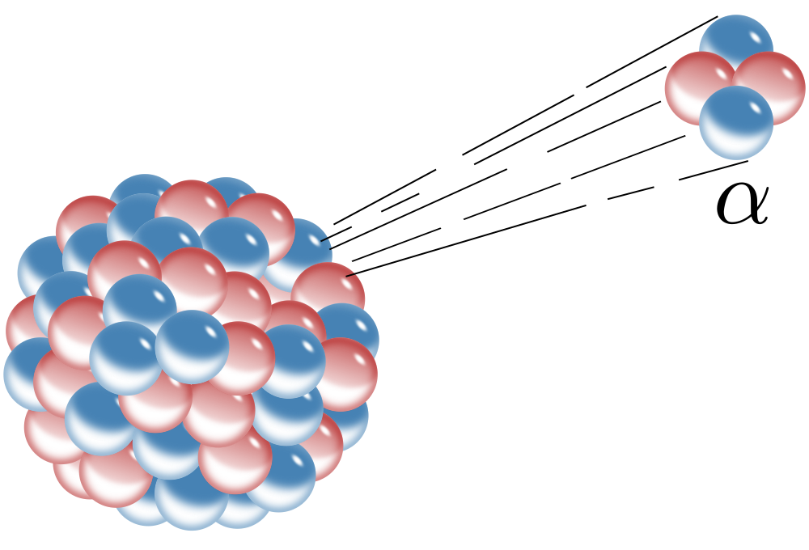
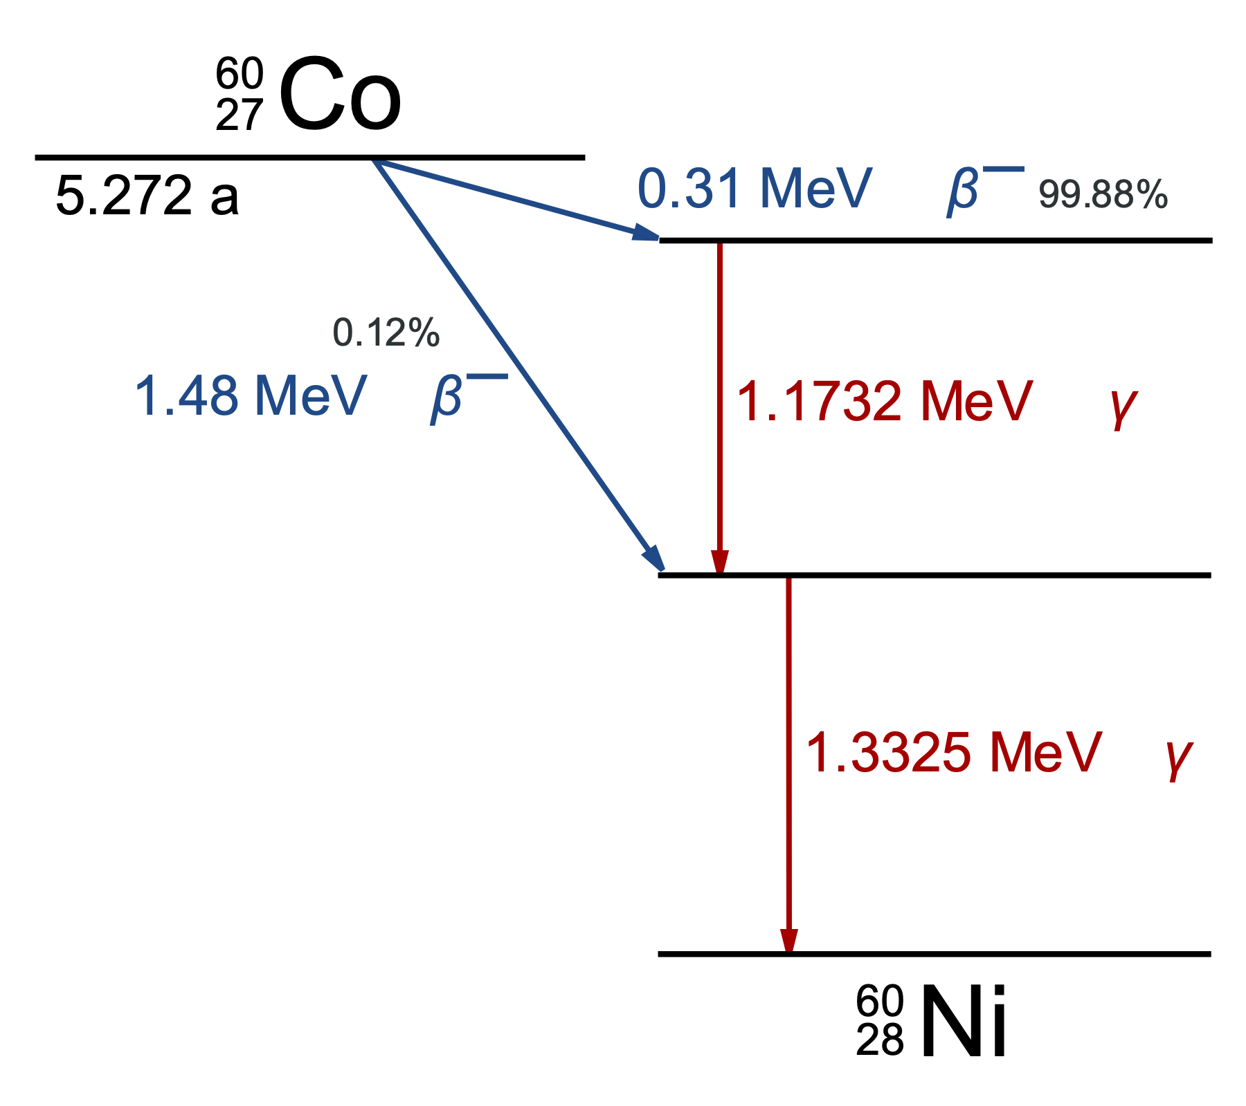
Physics Primer – gamma and X-ray production
When atoms decay (ex, 𝛼 or β decay, e⁻ capture, transmute (p↔n), etc) the nucleons may be left in an excited state; when they transition to a lower energy state, they may emit gamma rays
These gamma rays have specific energies - the energies, and probabilities of each energy has been characterized for almost all isotopes you may encounter
These gammas range from a few keV (λ~1 nm), to about 8 MeV (λ~0.1 pm)
The energies and relative probabilities are mostly unique between the different isotopes, so can be used to identify what radioactive materials(s) are decaying - this is gamma spectroscopy
A similar thing happens with the valence electrons, causing X-rays to be emitted, at nearly precise energies
Range from a few eV to ~120 keV
Gamma and X-rays are both just photons, the naming just differentiates how they were created
Alpha decay and energy level diagram by Inductiveload, Public Domain, https://commons.wikimedia.org/wiki/File:Alpha_Decay.svg and https://commons.wikimedia.org/w/index.php?curid=2859326

Slide 7
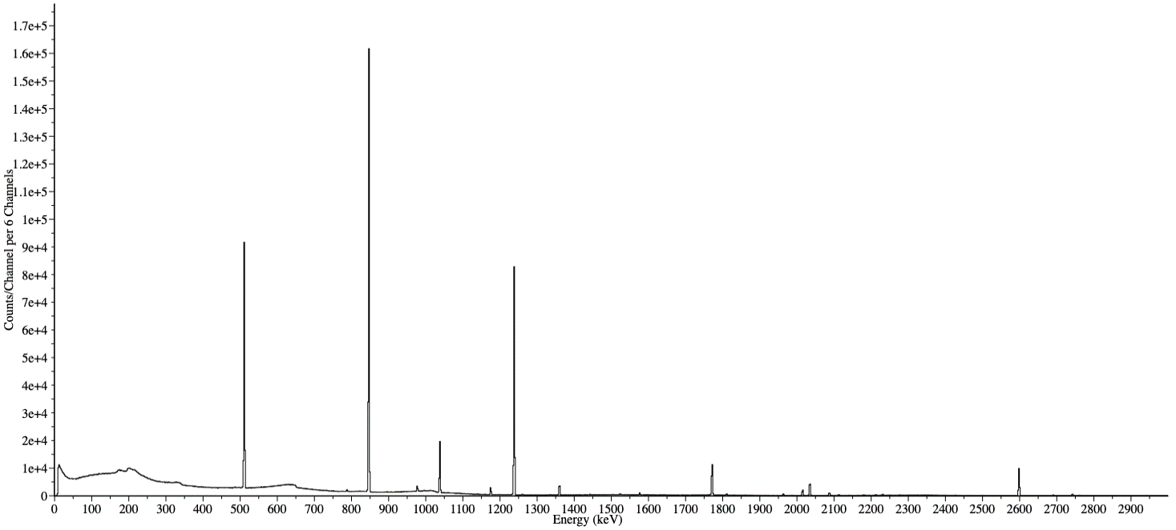
Physics Primer – example gamma spectrum for Co56
Distinct gamma energies, with distinct probabilities
As detected with a HPGe detector, and no terrestrial or cosmic background
Notes:
Co56 decays to stable Fe56

Slide 8
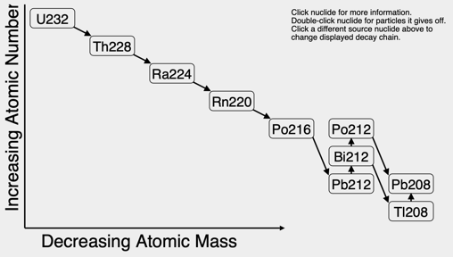
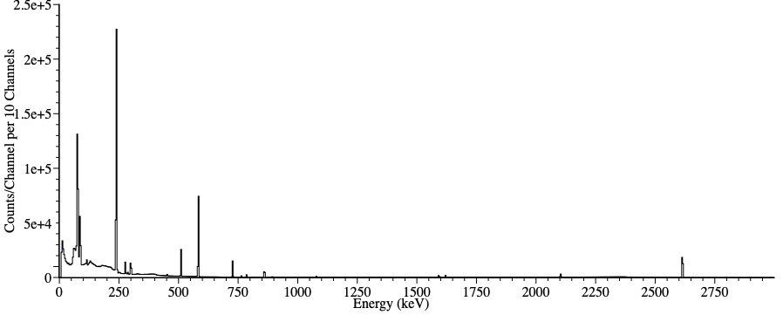
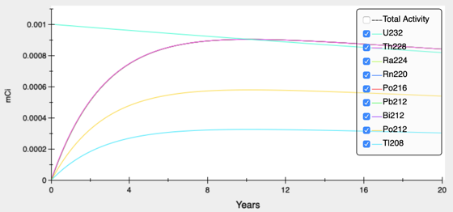
Physics Primer – example gamma spectrum for U232
Gamma and X-rays produced from a U232 sample come not just from U232, but from progeny that have grown in over time (e.g., the decay chain) – the spectrum of emitted gamma/X-rays will change over time

Slide 9
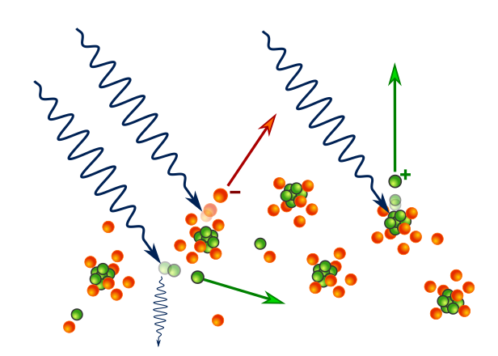
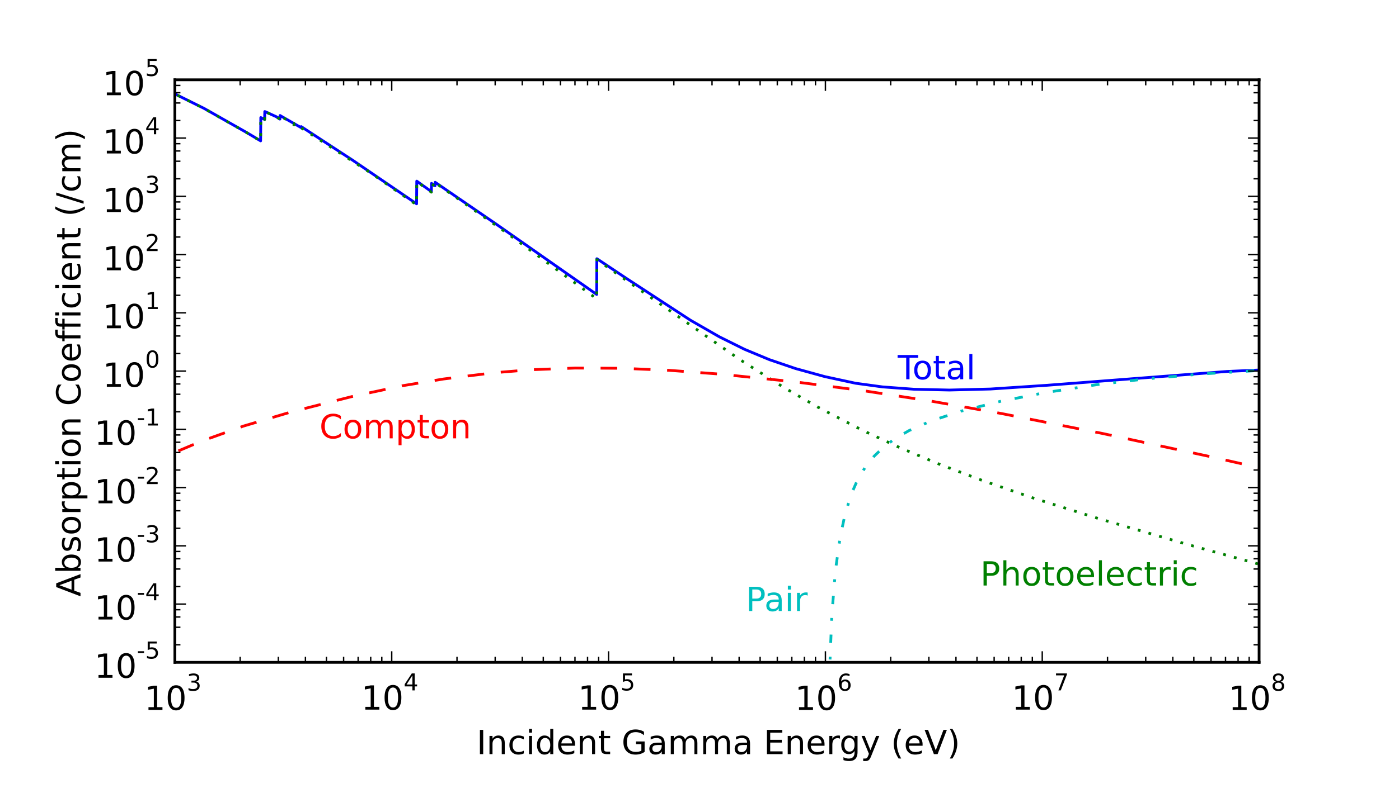
Physics Primer – gamma and X-ray interactions
Gamma and X-rays of interact with matter primarily by:
Scattering – gamma/X-ray changes direction and loses energy
Photoelectric – causing an electron to get ejected from the material
Pair production: interacts with a nucleus to produce a electron and anti-electron pair
These interactions are both energy dependent, and dependent on the atomic number of the material being interacted with
The probability of a gamma ray interacting with matter is:
I(𝒙) = I₀·e^{-n𝜎𝒙}
Where 𝜎 is the absorption coefficient (cm⁻¹), and 𝒙 is the thickness (cm), and n is atoms per cm³.
If you know the rate of each energy gamma/X-rays incident on material, you will know the rate of gammas that didn’t interact, and hence the rates of the original energies exiting the material
The relative rates of different energies exiting will be different
Ponor, CC BY-SA 4.0 <https://creativecommons.org/licenses/by-sa/4.0>, via Wikimedia Commons
This is for Lead – different for each atomic number
Joshua Hykes, CC BY-SA 3.0 <https://creativecommons.org/licenses/by-sa/3.0>, via Wikimedia Commons
Notes:
https://commons.wikimedia.org/wiki/File:Light-matter_interaction_-_schematic.svg
https://en.wikipedia.org/wiki/Gamma_ray#/media/File:Pb-gamma-xs.svg

Slide 10
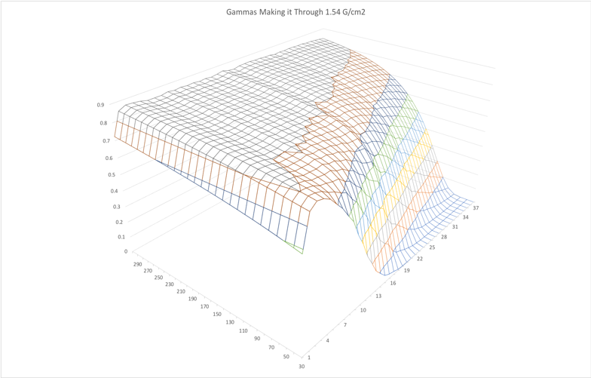
Physics Primer – interaction prob.: energy vs atomic number
The photon cross-section with matter varies by both photon energy and material atomic number
1-Fraction Interact
Atomic Number
Energy (keV)
Note that above ~300 keV all the atomic numbers start looking similar, so to distinguish AN of shielding, we’ll need gammas bellow 300 keV
Notes:
Think 2mm Fe
Code to generate this plots data:
std::ofstream outcsv( "/Users/wcjohns/Downloads/gamma_xs.csv" );
outcsv << ",";
for( float energy = 80; energy < 1001; energy += 20 )
outcsv << energy << ",";
outcsv << std::endl;
for( int atomic_number = 1; atomic_number < 68; ++atomic_number )
{
outcsv << atomic_number << ",";
for( float energy = 80; energy < 1001; energy += 20 )
{
const double arealDensity = 0.2*7.7;
const double mu = MassAttenuation::massAttenuationCoeficient(atomic_number, energy);
const double gPerCm2 = PhysicalUnits::g / PhysicalUnits::cm2;
outcsv << exp( -mu * (arealDensity*gPerCm2) ) << ",";
}
outcsv << std::endl;
}
return 1;

Slide 11
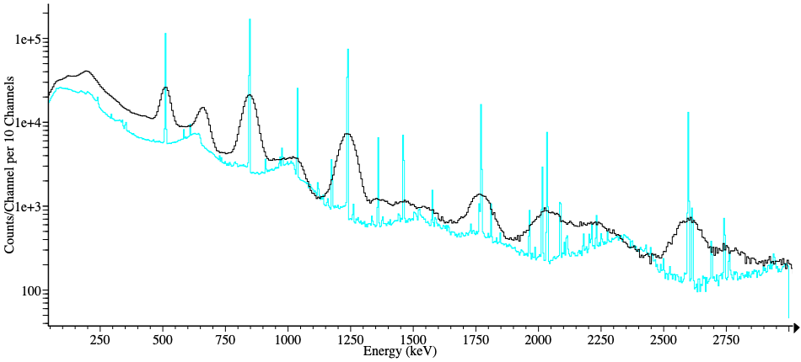
Physics Primer – gamma and X-ray detection
Gamma and X-rays are most commonly detected using either:
Scintillation systems: a crystal converts the incoming gamma/X-ray into a bunch of lower-wavelength photons whose intensity is proportional to incoming gamma energy
Example scintillators are: Sodium Iodide (NaI), Lanthanum Bromide (LaBr₃), Cesium Iodide (CsI), etc.
Semiconductor-based systems: these readout the charge carriers (electrons and holes) created in the semiconductor by the incoming gamma rays. Most common type is High-Purity Germanium (HPGe), and either liquid nitrogen, or mechanically cooled
From https://www.flir.com/products/identifinder-r400/
HPGe
Scintillator (NaI)
From: https://www.mirion.com/products/ulb-ultra-low-background-cryostats
From: https://www.ortec-online.com/products/nuclear-security-and-safeguards/hand-held-radioisotope-identifiers-riids/detective-x

Slide 12
Physics Primer – anatomy of the detected spectrum
When a gamma ray is incident on a detector, some things that may happen are:
Not interact with the detector at all
Scatter one-or-more times in the detection medium and then leave, depositing a portion of its original energy
Cause pair-production (create e⁺ and e⁻ pair) in the detector, with the e⁺ recombining with an e⁻ to create two 511 keV gammas – which one or both of may exit the detector without depositing their energy
Deposit its full energy in the detector. The full energy may or may not be read out.
The deposition and read-out of the full energy of the gamma/X-ray leads to photo-peaks
Otherwise, you get contribution to the continuum, backscatter/Compton “peaks”, or escape peaks

Slide 13
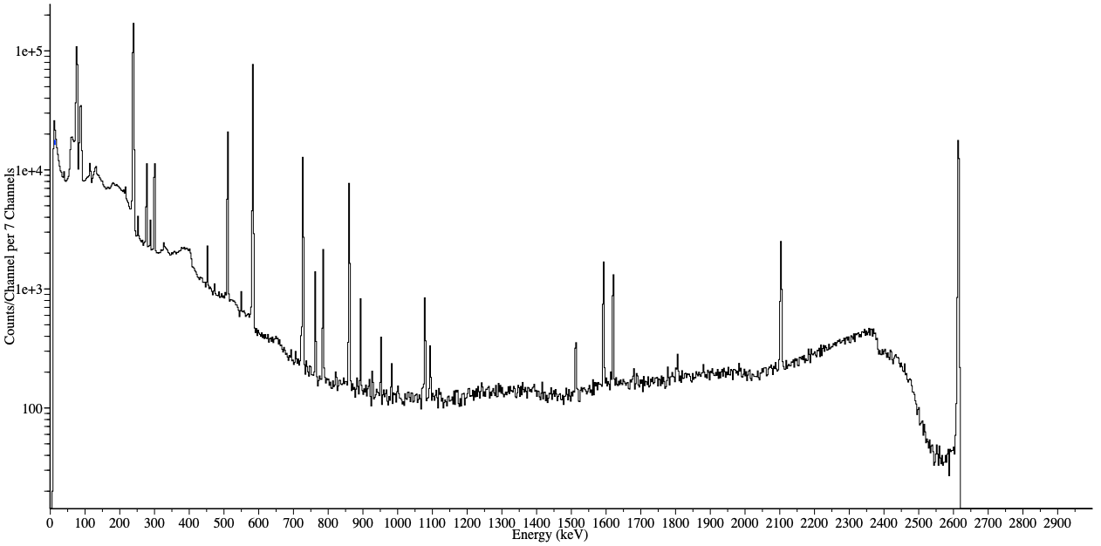
Physics Primer – anatomy of the detected spectrum (cont.)
A U232 spectrum, with no background, for a HPGe detector – log-y axis

Slide 14
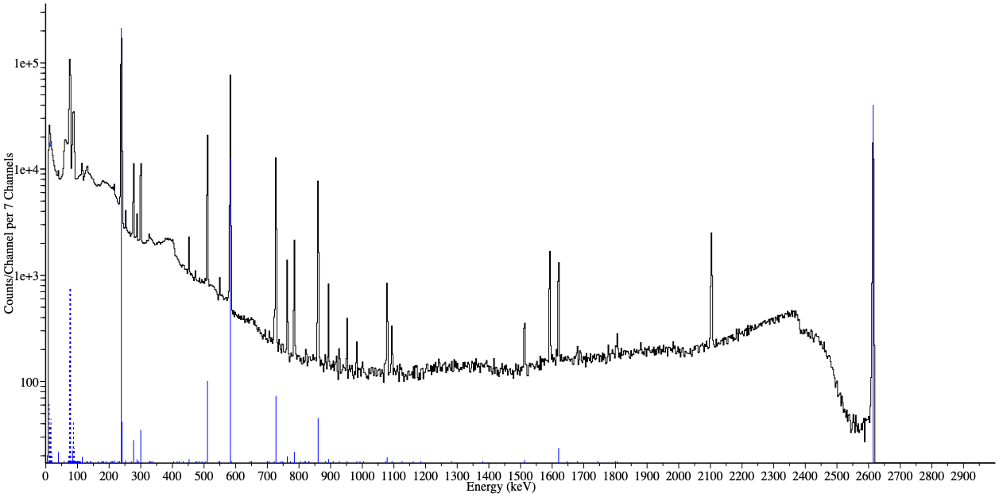
Physics Primer – anatomy of the detected spectrum (cont.)
Blue reference lines show gammas produced by U232 or its prodigy
Dashed blue lines are X-rays produced during decay
The “Photopeaks” are Gaussian shaped, and are the result of the detector absorbing and reading out the full-energy of incoming gammas
The Gaussian part is primarily due to statistics effects of detection mechanism
X-ray peaks have a small intrinsic Lorentzian component due to source X-ray
Note: the y-axis is log, but reference lines are shown linear to kinda compensate for continuum

Slide 15
Physics Primer – anatomy of the detected spectrum (cont.)
Pair-production leads to escape peaks being found 511 keV and 1022 keV below the higher energy gamma lines
2614 keV
Gamma Photopeak
1592 keV
Double Escape
2103 keV
Single Escape
Note: the y-axis is log, but reference lines are shown linear to kinda compensate for continuum

Slide 16
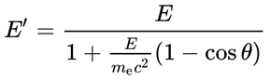
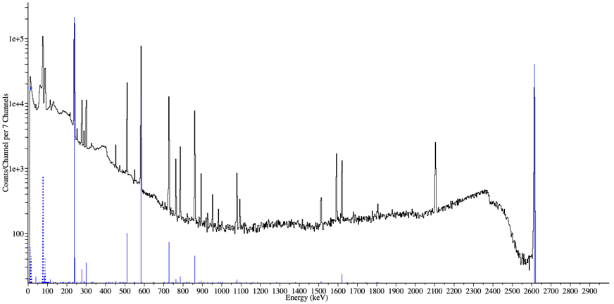
Physics Primer – anatomy of the detected spectrum (cont.)
A Compton-scatter inside the detector leads to partial energy detection, and contributes to the continuum
Outgoing ɣ energy
Initial ɣ energy
A 180° scatter is max. energy deposited – giving a Compton edge, in this case due to the 2614 keV gamma
Scatter angle
Continuum
Multiple scatterings and exit

Slide 17
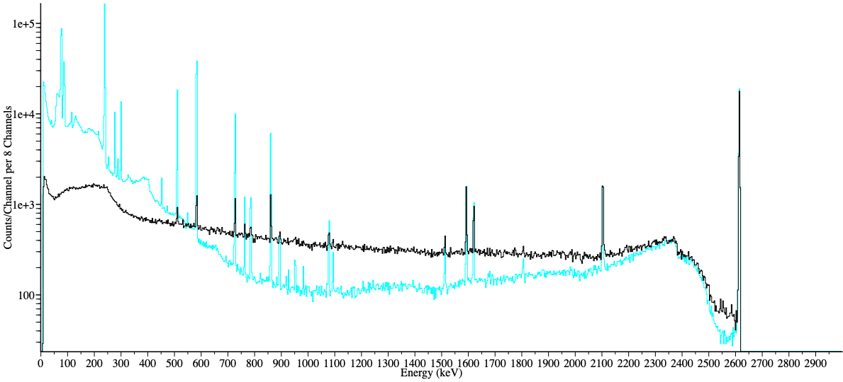
Physics Primer – anatomy of the detected spectrum (cont.)
Scatter in material outside detector causes gamma incident on detector to not contribute to photo-peak since those gammas are now at lower energy
Compton “peak” created by scatter outside of detector
(location for a given gamma-energy is angle dependent)
The relative attenuation of Photopeaks is energy dependent, with low energy gammas impacted more
Stronger U232 source through 4.4 cm of Lead
Unshielded U232

Slide 18
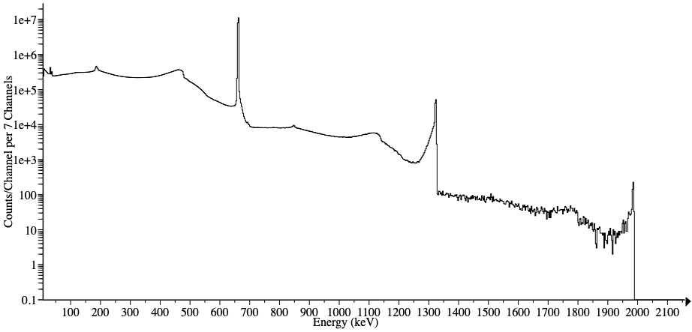
Physics Primer – anatomy of the detected spectrum (cont.)
Cs137 spectrum, that has only a single gamma at 661.7 keV
Sum peak at 661.7+661.7 = 1323.4 keV
1323.4+661.7 = 1985.1 keV
Full-energy + scatter, etc
At high count-rates multiple gammas may get counted as a single event
Most detectors integrate signal for a fixed amount of time to get an energy – two gammas may enter the detector during this time frame
There is also usually a “dead-time” after each detection event during which new gammas cant be detected
Some nuclide have “cascade” decays that emit multiple gamma rays close in time to each other

Slide 19
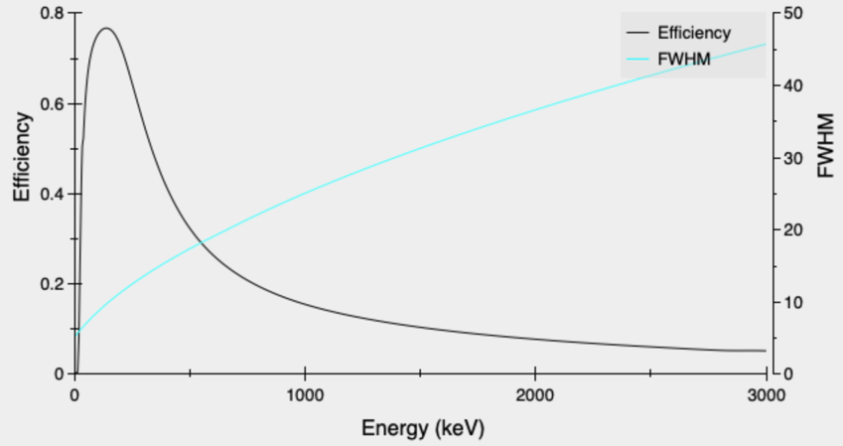
Physics Primer – gamma/X-ray detection efficiency
We can characterize the efficiency, as a function of energy, to detect the full-energy of an incident photon for a given detector
We usually do this by using radioactive sources of known activities, that give off different energy gammas (with known intensities) and then fit to a function. But also sometimes simulation or parameterization can be used
A typical intrinsic efficiency curve
FWHM = Full Width at Half maximum = 2.355·Gaussian sigma → width of peaks as function of energy

Slide 20
Physics Primer – putting it all together
We know:
The energy and intensity that radioactive nuclides will produce
The decay-chains of nuclides
The amount of attenuation material/shielding will provide, as a function of gamma/X-ray energy, and material atomic number
The efficiency to detect a gamma incident on the detector, as a function of energy, and the geometric eff.
So if we have a gamma spectrum, by doing a peak-based analysis, we can (potentially):
Determine what the source nuclide is, from the energy gamma and X-rays we observe
Determine the activity (decay rate, or equivalently how-much there is) of the nuclide
Determine how-much, and maybe even the atomic number, of the shielding the gammas are going through, by the relative intensities of Photopeaks
Maybe determine source age, if the gamma spectrum changes with age
But there may be degeneracies:
ex, for nuclides with a single peak, like Cs137, you can only determine activity, if you know shielding
ex, you might only be able to determine atomic number of shielding if you have lots of peaks, with some at low energy, and others at higher energies

Slide 21
Basics of using InterSpec to look at data

Slide 22
Obtaining data to analyze
Most detection systems meant to measure gammas from radioactive decays of nuclides with half-lives longer than a few minutes produce a “spectrum file” that contains the counts for each energy channel
Usually either 256, 512, 1024, 2048, … or 65,536 channel histogram of counts vs energy
Often sensitive to gammas between ~30 keV and 3000 keV, but may go down to a few keV, and up to 8 or 9 MeV
Usually provide a “real time” (how long measurement was), and a “live time” (approx. real time minus dead time)
Some systems produce “list-mode” data – i.e., each detection event separately time-stamped - if you are using this data, you are probably doing something specialized
Measurements are usually ≳30 seconds, and may be days long
The lower time limit is kinda determined by max rates systems can handle, and needing reasonable statistics to analyze in the spectrum
Some systems may create spectrums of successive short duration, that you can sum later
E.g., consecutive 0.1s spectra for minutes or hours in a row
Lots of spectrum file formats: CNF, N42, CSV, TXT, LIS, SPE, SPC, …
From https://www.flir.com/products/identifinder-r400/
From: https://www.mirion.com/products/ulb-ultra-low-background-cryostats
From: https://www.ortec-online.com/products/nuclear-security-and-safeguards/hand-held-radioisotope-identifiers-riids/detective-x

Slide 23

Loading data into InterSpec
Easiest way to load spectra is to drag-n-drop spectrum file from the operating system
You can load files from the “File” menu, or associate spectrum files to open when you double click the files

Slide 24
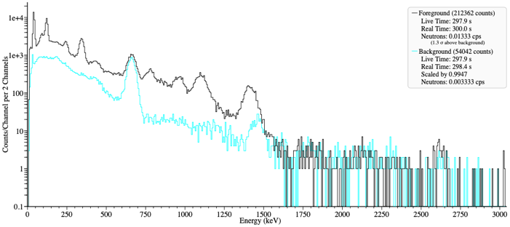
Loading data into InterSpec (cont.)
This background tells us:
Peak at 661 keV is not from the IOI
No IOI gammas above ~1500 keV
Sometimes your spectrum file of your item of interest (IOI) will also contain a background spectrum, but sometimes this might be a separate file; you can open as background by dropping it as shown above
Background spectra are of the environmental radiation, without your IOI present
You usually don’t need a background file for IOI analysis in InterSpec, but they are often nice to have as a reference
It can also be nice to open a known-source as the 2nd foreground as a sanity check of energy calibration

Slide 25
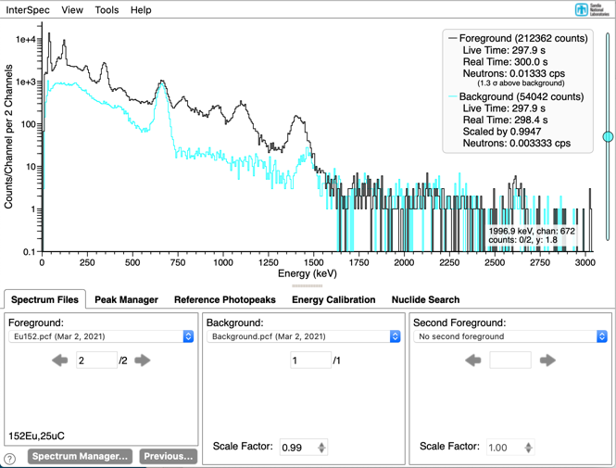
Spectrum Display Basics
Y-axis defaults to log scale, but can be made linear
Legend tells you real and live times, as well as neutron information if available
If there aren’t enough pixels to display each energy channel, adjacent channels are summed for display
By default background and 2nd foreground are live-time normalized to foreground – but this can be adjusted
e.g., if background is twice as long as IOI, it is displayed at half height

Slide 26
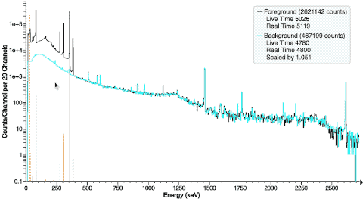
Interacting with spectra
Zoom in: click and drag to the right to highlight the region you want to zoom in to. When you let go of the mouse, it will zoom in.
Zoom out: click and drag to left; zooming out will happen continuously
To pan left or right: use the RIGHT mouse button to drag left and right. Or click and drag labels (numbers) on the x-axis
Or you can use the up and down mouse-wheel to zoom in and out, and wheel left/right to pan (or trackpad equivalents)
Touch screens work to, and basics are reasonably intuitive
You can also zoom in on the y-axis by holding the option key (mac: command) clicking and dragging down, and do same thing but up to zoom out. Or you can click and drag on y-axis labels (numbers), or for more control use the mouse-wheel when mouse is over y-axis area

Slide 27
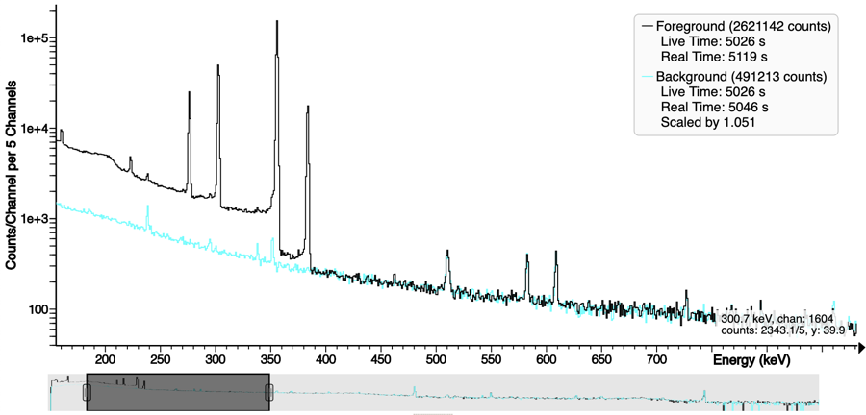
Interacting with spectra (cont.)
View → “Show Energy Slider” will bring up a strip chart
Drag on edges to change displayed energy ranges, or click and drag on dark part to pan
Especially useful for really inspecting HPGe spectra

Slide 28
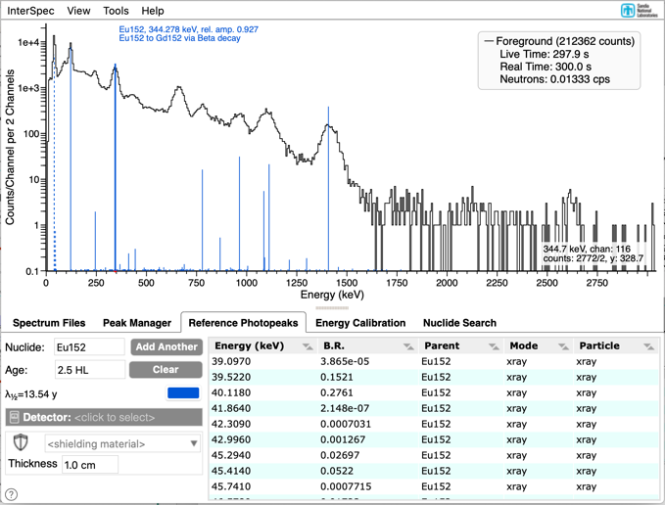
Showing reference gamma lines
On “Reference Photopeaks” tab, you can enter any nuclide to display its gamma and X-rays on the spectrum
Moving your mouse over a line gives you more info about what makes that gamma
Table of all gammas and X-rays for the selected nuclide, and its progeny
Add effects of aging, detector efficiency, and shielding to the amplitudes of displayed lines

Slide 29
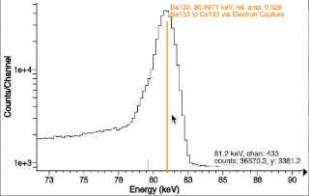
Basic peak-fitting
Usually to fit a peak, just double click near it.
Want to add on other nearby peak? Just double click again.
If you move your mouse to the edge of the Region Of Interest (ROI), you can adjust ROI extent.
Right-click on a peak to get a menu to add or remove a peak from a ROI, or access an advanced “Peak Editor”

Slide 30
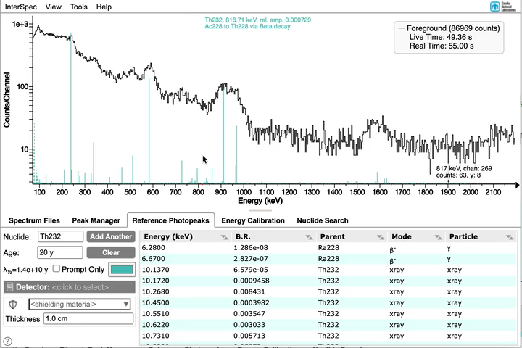
Peak Fitting (cont.)
Holding control and dragging across a region lets you fit for multiple peaks in a ROI

Slide 31
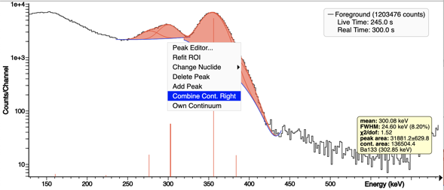
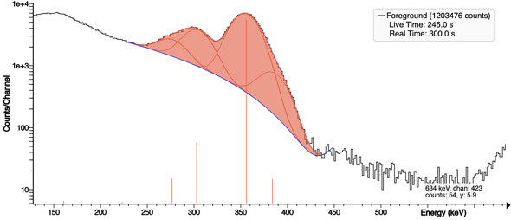

Peak Fitting (cont.)
Peaks can share a continuum
Usually InterSpec will do a decent job of having peaks share a continuum when it’s useful, but you can always right-click on a peak (or touch, hold down on the peak for a second) and choose to “Combine Cont. Right/Left” or “Own Continuum”.

Slide 32
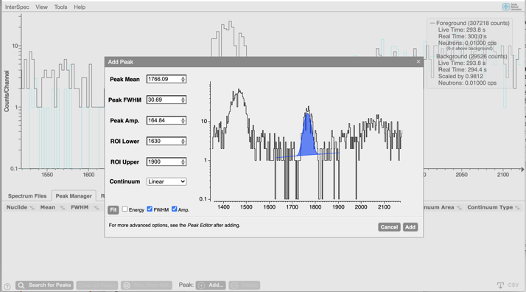
Peak Fitting (cont.)
As a last resort, if InterSpec just really refuses to add a peak where you want one, on the “Peak Manager” tab, there is an “Add…” button that gives you more control over adding the peak and overrides statistical tests and such to force adding one
This is usually only necessary for peaks of dubious statistics or shape, or when there is a small peak “on the side” of a larger peak
After adding a peak this way you can further modify it, or you can join the new peak to the continuum of a previous peak

Slide 33
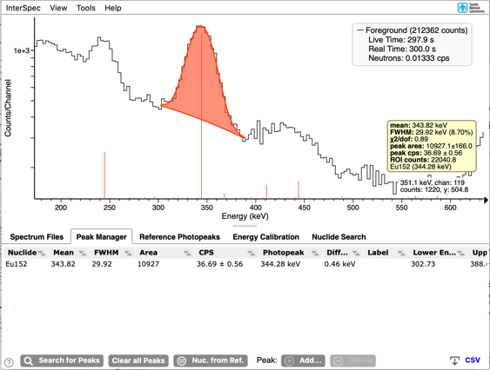
Peaks – associating nuclides
A key part of using InterSpec is that you can associate peaks with nuclides/X-ray/reactions
If you are showing reference photopeak lines before fitting a peak, the fit peaks will automatically get associated with the nuclide and specific gamma or X-ray
Peak info that gets shown when you mouse-over a peak. Includes associated nuclide info
Associating nuclides with peak allows: keeping track of nuclide ID, determining source activities, using to correct energy calibration, or creating detector response functions

Slide 34
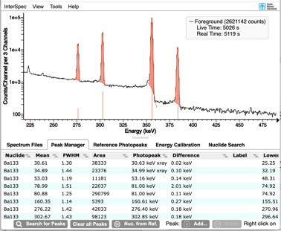
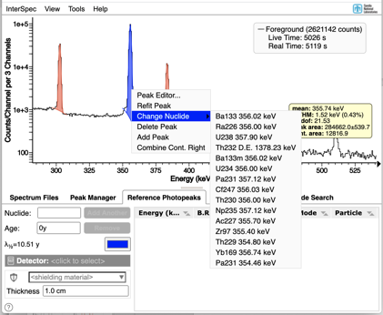
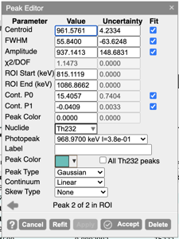
Peaks – associating nuclides (cont.)
You can click on any of the peak tables to edit the nuclide and photopeak.
On “Peak Manager” tab there is also a “Nuc. From Ref.” as well
Right-clicking a peak and going to “Change Nuclide” item will bring up a decent selection of suggested nuclides
Suggestions based on energy, other peaks in spectrum, currently showing reference lines, and a general suggestion algorithm
The peak-editor (from right-clicking on a peak) also lets you select the nuclide and energy

Slide 35
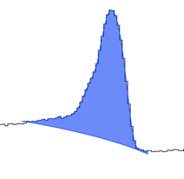
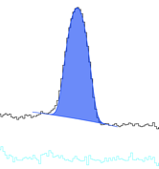
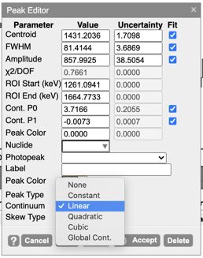
Peaks – how they are defined
Peaks can also be “data defined” meaning their amplitude is the area between the continuum observed counts
Peaks default to being Gaussians sitting on top of a polynomial continuum
You can choose the order polynomial to fit as the continuum, or you can use a “global cont.”
The global continuum is calculated for the entire spectrum using a relaxation method
There is a “Skew Type” option, that will likely be much improved in the next version of InterSpec
Recommend sticking with Gaussian + Polynomial unless it really isn’t working

Slide 36
Nuclide ID
How to figure out what nuclide produced a photo-peak

Slide 37
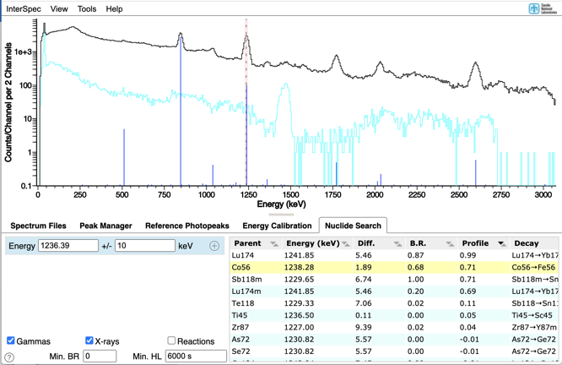
Nuclide ID
The two primary tools to help you with nuclide ID in InterSpec are “Nuclide Search” and “Reference Photopeaks”
InterSpec does not perform nuclide ID, but assists you, with the ID
Before performing a nuclide ID, check your energy calibration (fixing energy cal. covered later)

Slide 38
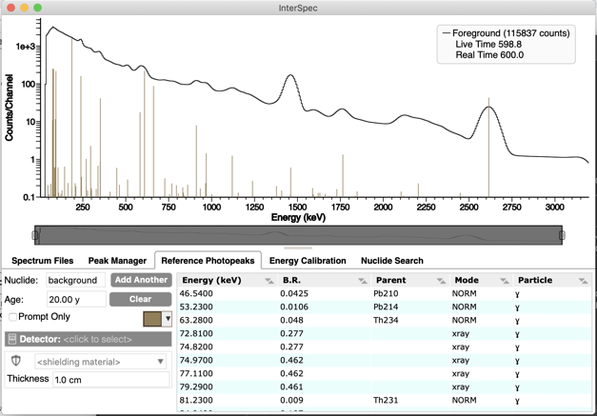
First, check your energy calibration
A recent spectrum of a known test source is best, but looking for background peaks in the primary spectrum or provided background may be good enough
You can provide “background” as a nuclide in the reference photo-peak tool to see most common background lines.
Intensities will of course vary with geographical location, but taller lines are generally more likely to be seen

Slide 39
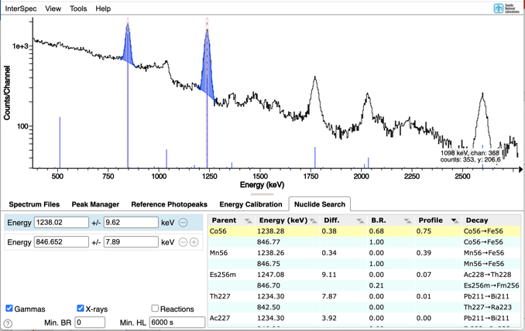
Nuclide Search
The “Nuclide Search” tool provides you a list of nuclides and reactions that have gammas, or optionally X-rays, within specified energy windows.
You can have any number of energy windows; results will have a gamma or X-ray in each window
More windows narrows choices, but also increases probability peaks are from separate nuclides
Clicking on a row in the results table will show reference lines for that nuclide – you then perform an interocular assessment if that is the correct nuclide for your spectrum

Slide 40

Nuclide Search (cont.)
Clicking on the spectrum while the “Nuclide Search” tab is showing will put the energy you clicked on into the entry form; you can then click somewhere else, and it will fill in the next energy entry.
If you click near a peak (within 1.15*FWHM), the window-width will be filled out as well; for HPGe will be 1 FWHM of the peak, and lower resolution detectors will be 0.35*FWHM.

Slide 41
Nuclide Search (cont.)
You can add or remove energy windows using the “+” and “-” buttons

Slide 42
Nuclide Search (cont.)
You can also specify a minimum half-life (of the parent nuclide)
useful to eliminate the many very shortly lived nuclides; default is 100 minutes
You can also specify the minimum branching-ratio gammas must have to be considered for matching in the energy windows
Useful to eliminate nuclides that have a ton of low-intensity gammas
This actually filters based on the fraction of gammas at each energy, at each stage of decay, so some lower-BR gammas may still get included

Slide 43
Nuclide Search (cont.)
The energy matching is performed after decaying each nuclide, so that all prodigy are also considered in doing the match; the last column on the right show you which decay in the chain the gamma comes from
All >4000 nuclides, and ~110,000 gammas are considered for the search
X-rays above ~10 keV are considered for all elements
About 200 alpha,n, n,alpha, alpha-proton, n-capture, and inelastic n-scatter reactions are considered

Slide 44
Nuclide Search (cont.)
You can sort results by any column by clicking on the table header
The “Diff.” column is the sum difference between the search energies, and the matching gamma
The “B.R.” column is, after decay, the relative intensity of the gamma, to the largest intensity gamma of the decay
A heuristic is used to select the age to decay nuclides to based on if it can reach secular equilibrium, half-life, and descendants half-life
The “Profile” column is default, and almost always provides best result

Slide 45
Nuclide Search (cont.)
The “Profile” column is a heuristic that ranges between -1 and 1 to give you a relative idea of match quality
Use this value relative to other search results – it doesn’t have an absolute meaning
This value takes into account all peaks in the spectrum (the ones you’ve fit, plus ones returned from an auto-search), a few possible shielding and aging scenarios, relative amplitudes of peaks, and gamma-lines that should-have created a peak but where no peak is observed
Normally much better than ordering by “Diff.” or “B.R.”

Slide 46
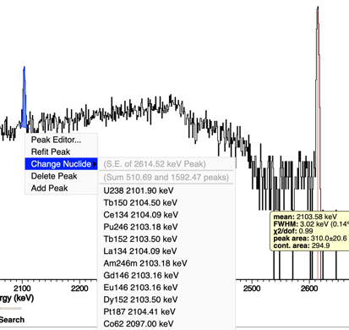
Suggested Nuclides
Right-clicking on a peak will also suggest nuclides, or reactions, sum-peaks, escape peaks, etc. in a reasonable way, but it is not an automated nuclide ID algorithm

Slide 47
Fitting for activity and shielding
Let’s cut to the chase, and do something interesting!

Slide 48
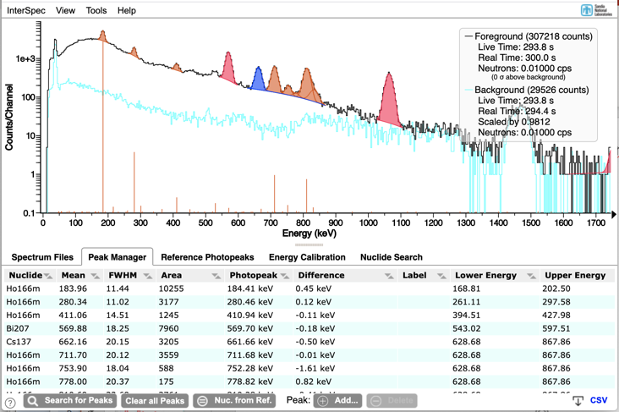
Fitting activity, shielding, and age in InterSpec
First: fit peaks, associating them with nuclides
Peaks that are in both the background and foreground do not need to be fit. Or if a peak is for a nuclide you don’t care about you can skip it
If you have lots of peaks for a nuclide, like a HPGe spectrum of Ra226, you can maybe fit for just the larger ones

Slide 49
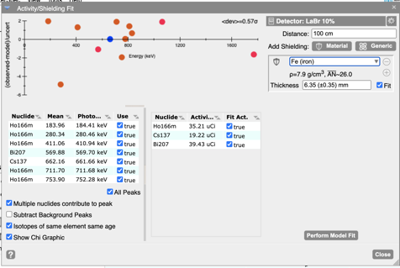
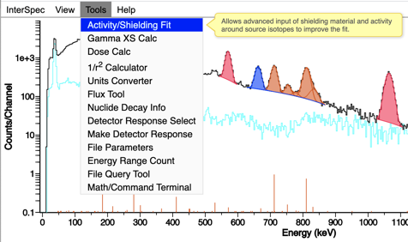
Fitting activity, shielding, and age in InterSpec (cont.)
From the “Tools” menu, select “Activity/Shielding Fit”

Slide 50
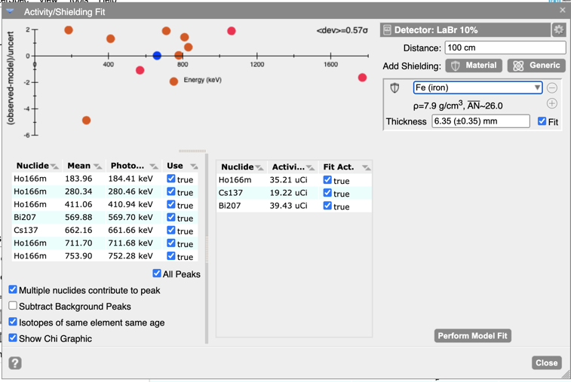
Activity/Shielding Fit Tool
Select detector response function (DRF aka intrinsic efficiency)
Get an idea of how good the fit is
Enter distance
Select shielding(s)
You can select peaks to use in the fit
Fit for the quantities you want
Some options
Decide if you want activity and/or age fixed for each nuclide

Slide 51
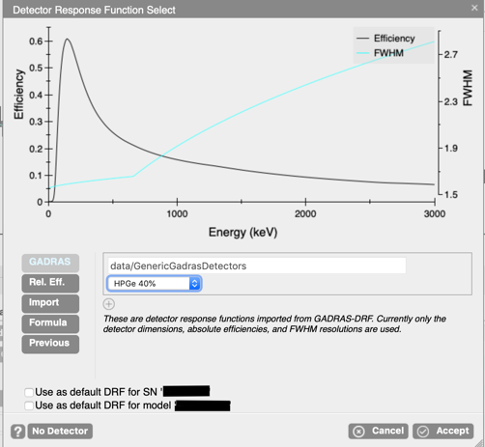
Activity/Shielding Fit Tool (DRF)
If you click/tap on the detector area, it will bring up this Detector Response Function, DRF, selection dialog
This dialog lets you choose from some generic DRFs that come with InterSpec, enter your own DRF equation, upload a DRF, or select from previous DRFs
InterSpec has a tool, “Make Detector Response” that helps you to create a detector response

Slide 52

Activity/Shielding Fit Tool (peaks to use)
All of the peaks you have fit for the foreground will appear in this list.
You can choose if a peak should participate in the fitting process.
We’ll cover strategies for deciding if a peak should be included during exercises
Any nuclides associated with the peaks you have selected, will appear here
You can manually edit an activity, and choose not to fit it, if you happen to know it, but not the shielding
Not shown above, but age of nuclides is also editable, or fittable for applicable nuclides

Slide 53
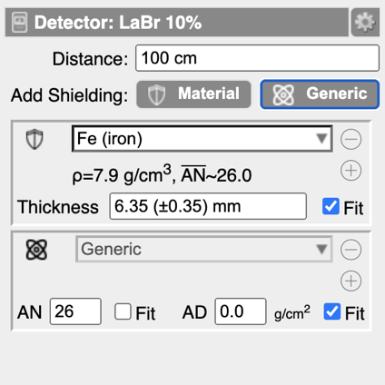
Activity/Shielding Fit Tool (shielding)
Clicking on these icons will toggle between shielding types
The shielding can be either a specific type of material from InterSpec’s database, or it can be a generic material where you specify the atomic number (AN) and areal density (AD), or you can enter a chemical formula and density.
You can choose to fit for, or fix, thickness, AN, and AD
You can have multiple shielding's, but of course this can get degenerate to fit for multiple of them, especially if they have similar effective atomic numbers

Slide 54
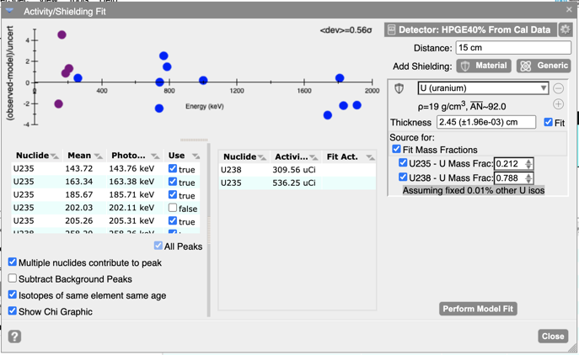
Activity/Shielding Fit Tool (shielding cont.)
If your shielding contains the same element as one or more of the nuclides you are fitting for, you will be given the option to have the shielding become the source term
In this case self-attenuation is taken into account; especially useful in high-Z materials (W, Th, U, Pu, etc)
InterSpec uses an adaptive quadrature based ray-tracing algorithm to account for self-attenuation and geometric effects
If there are multiple nuclides composing the shielding you can fit for the isotopics as well

Slide 55
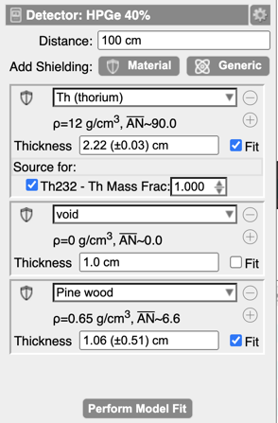
Activity/Shielding Fit Tool (shielding cont.)
Inner shell
2.22 cm solid sphere of Thorium metal
A 1 cm gap outside the Thorium
Outer shell
A 1.06 cm shell of wood
InterSpec uses a spherical geometry when self-attenuating sources are used
Nuclides that aren’t part of shielding's are point-sources at the center of all shieldings

Slide 56
Activity/Shielding Fit Tool (distance)
The distance is from the detector face, to the center of shielding
Distance, like times, can be entered in fairly flexible formats; the following are all valid distances:
“1.2cm”, “1ft”, “1 ft 13 in”, “1' 13"”, “3 m”, “3 meters”, “3.6E-2 m”, etc.

Slide 57
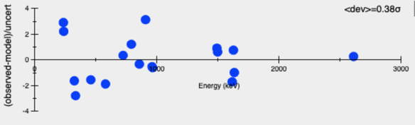
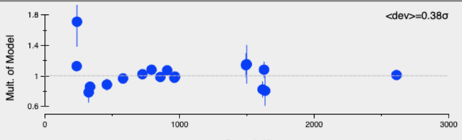
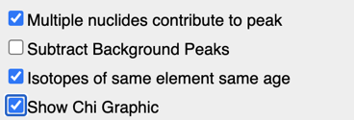
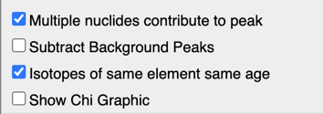
Activity/Shielding Fit Tool (Chi graphic)
The graphic in this tool is to help provide you an idea of how well the data lines up to the model
Left: chart shows you how many statistical deviations each peak is away from the model
Right: chart shows you the multiple of how far away from the model each peak-area is. The error bars are 1-sigma statistical uncertainties.
I.e., if the dot corresponding to a peak is at 2.0, that indicates that peak would give double the activity that is currently showing
Generally, if after doing a “Perform Model Fit,” a peak is greater than maybe 5-or-so-sigma away from the nominal value, you should consider removing that peak from the fit, or checking that it’s associated with the correct gamma line, or that there isn’t an interfering nuclide that you aren’t currently fitting for

Slide 58

Activity/Shielding Fit Tool (options)
Multiple nuclides contribute to peak: if two or more nuclides being fit contribute to a peak, allow all of the nuclides to contribute to calculating the expected peak area, not just the nuclide assigned to the peak
Subtract Background Peaks: useful if background peaks contribute to your isotope of interest. To enable this option you must have a background spectrum loaded, and you must have the background peaks fit in it
To fit the peaks in a background spectrum, first load it as a foreground spectrum, fit the peaks, then load your foreground of interest file, and from the “File Manager” tab select the first file as background
Background peaks do not need nuclides associated with them; matching which peaks to subtract from which is based on energy
Isotopes of same element same age: If you are fitting for the age of a material, like Th, U, Pu, etc., and you want to constrain all isotopes for an element to be the same age, select this option
Show Chi Graphic: Selects between the two different style graphics

Slide 59

Activity/Shielding Fit Tool (more…)
Clicking on the gear icon brings up a menu that lets you:
See a log of calculations, which has a whole bunch of details about what exactly went into the calculations
You can save, export, import, or load a previous model. Useful if your model is complex.

Slide 60
Activity/Shielding Fit Tool (general notes)
This tool requires use of your critical thinking and spectroscopy knowledge – you can do things that don’t make sense
E.g., if you try to fit for atomic number of shielding using two close-together peaks, or two high-energy peaks, you will get a nonsense answer (but you should also get a large error as well). Or if you fit for the age of a nuclide that has already reached equilibrium, you might get a really large age (but also hopefully large uncertainty)
InterSpec doesn’t currently do a great job of detecting and notifying you of degeneracies being fit for
Large uncertainties are a “smell” of these
You can only fit for as many quantities as you have peaks for
If you are fitting for the effective atomic number of your shielding, having one or more peaks below 300 keV is usually necessary (see slide 10)
Always ask yourself if the results make sense
Uncertainties given are only statistical. Uncertainties about your DRF, peak-skew, distance, material composition, or other factors may dwarf the statistical uncertainties

Slide 61

Let’s work an example problem together:
Example1.pcf and Example1_background.pcf
A metal container was located that was giving off increased radiation
A 5 minute spectrum was taken from 1 m away, along with a 5 minute representative background; both using the same 3x3 NaI detector☨
You would like to determine:
What nuclides are present inside the box?
The nuclide(s) activity?
How much shielding is present?
Detector
1 m
(The next bunch of slides is for later reference – we’ll work it live)
☨ 7.62 cm diameter by 7.62 cm long NaI crystal – will produce the conceptually same spectroscopic data as an identiFINDER or RadSeeker

Slide 62

Example 1 (cont.)
The background peaks at 1460 keV (K40), 609 keV (Ra226), and 2614 keV (Th232) look to be at the expected energies
The energy calibration is acceptable, and it looks like we got the correct files off the detector

Slide 63


Example 1 (cont.)
There are two obvious photo-peaks in your item of interest spectrum that are not in the background spectrum.
You can fit peaks by double-clicking near them.

Slide 64


Example 1 (cont.)
Let’s figure out what nuclide causes these photopeaks by using the “Nuclide Search” tab
When on the “Nuclide Search” tab if you click on a place in the spectrum – that energy is filled in to search on
The number of energies can be changed by using the + and - icons

Slide 65

Example 1 (cont.)
Clicking on a nuclide will cause the reference photopeak lines for that nuclide to be shown
Here Fm256 is clearly not right because we would see many other peaks

Slide 66

Example 1 (cont.)
Its usually best to sort this table by the “Profile” column (default), but other ordering can be changed by clicking on the headers for other columns
It’s a little hard to see, but the reference lines for Na22 line up exactly with the observed peaks – and we aren’t missing any peaks we would expect for Na22 – so this is our nuclide

Slide 67
Example 1 (cont.)
Now we need to assign nuclides to these peaks because reference lines were not showing before we fit the peaks:
If you right-click on the peak, and go to the “Change Nuclide” menu-item, you can select Na22, or there are a number of other possible isotopes that it could be from

Slide 68




Example 1 (cont.)
You can also assign nuclides to peaks, in a number of other ways:
By typing the nuclide name into the “Peak Manager” tab
The “Peak Editor” tool (opened by right clicking on peak and selecting “Peak Editor…”)
Mousing over a peak causes a pop-up that shows info about the peak, including nuclide
Or if you are showing reference photo-peak lines when you fit for a peak, the peak will automatically be associated with that nuclide

Slide 69

Example 1 (cont.)
Fit for the source activity using the “Activity/Shielding Fit” tool

Slide 70


Example 1 (cont.)
Select the detector response function you want to use by clicking here
Note: there is a bug in InterSpec v1.0.7 – you may not see the “Use” checkbox for the 511 keV peak

Slide 71
Example 1 (cont.)
Enter distance of measurement

Slide 72
Example 1 (cont.)
Select which peaks you would like to use

Slide 73
Example 1 (cont.)
Add a shielding
Here we added a single iron shielding
Make sure you are fitting for activity, and shielding thickness

Slide 74
Example 1 (cont.)
Click here to fit for desired quantities

Slide 75
Example 1 (cont.)
We fit for 40 uCi of Na22, with 3.4 cm of Iron Shielding
Truth level: 50 uCi at 3.48 cm Fe - not bad!

Slide 76
Example 1 (cont.)
This “Chi2” graphic shows you how many statistical sigmas the fit peak areas are off from what is predicted for the fit activity and shielding
Here we fit for two quantities (activity and shielding thickness), using two peaks, so both peak areas should be at essentially zero sigmas. If we had more peaks we would expect a distribution ranging between about ±5 sigmas (or maybe a little more)

Slide 77

Fitting multiple sources
Load multisource.n42. We will use it as an example of fitting multiple nuclides.
It is a 10% LaBr detector, distance is 100 cm, and shielding is Fe.
Peaks have already been fit to save some time – spectrum contains Ho166m, Cs137, and Bi207

Slide 78
Energy calibration

Slide 79

Energy Calibration – a primer
Most spectrum files specify energy of each channel, using a polynomial
The energy of channel i is: $E_{i}=c_{0}+c_{1}×i+c_{2}×i^{2}+c_{3}×i^{3}+ …$
Spectrum file gives the coefficients $c_{j}$, usually 2 or 3 of them, but sometimes up to ~5.
c₀ is often times called offset, c₁ is gain, c₂ quadratic
Sometimes spectrum files will instead give the lower channel energies for each file
Common in CSV or simple ASCII files, but can also be in N42 and PCF files
A detector’s energy calibration may not always be great, so sometimes adjustments may be necessary before analyzing data – there are a few ways to do this in InterSpec
This presentation will ignore less-common situations like non-linear deviation pairs, full-range fraction coefficients, or multiple detectors in a single system – for those and other more advanced topics see
https://sandialabs.github.io/InterSpec/tutorials/#overview-course-sep-2020

Slide 80

Energy Calibration (cont.)
You can manually adjust parameters until the photopeaks line up with where they “should” be

Slide 81

Energy Calibration (cont.)
You can fit for peaks associated with nuclides, and use those to “fit” for the best coefficients
2) Select which order coefficients you want to fit for
3) Push “Fit Coeffs”
1) Select the peaks you want to use for the fit

Slide 82


Energy Calibration (cont.)
If Ctrl+Alt+drag again within 2 minutes, one of the options will be to preserve your last calibration
This is useful to adjust both the gain and offset using a low and high energy peak; when you do the second calibration this option will keep your previous peak at the same location you drug it to
You can graphically recalibrate by holding Ctrl+Alt and dragging the spectrum to where you want

Slide 83
Other tools in InterSpec, and some more useful information

Slide 84




Other useful tools in InterSpec – Nuclide Decay Information
Provide ingrowth and decay rates for a mixture of nuclides over time
Clicking on the chart gives decay products at that time
You can export a CSV that includes the information and timing you want to work with in other applications
Double click on source text to change nuclide, activity, or initial age
Provide ingrowth and decay rates for a mixture of nuclides over time
Clicking on a nuclide in decay chain gives more information about it
Double-clicking on a nuclide in decay chain provides its decay products
You can also show all decays through a nuclide (e.g., all possible parent nuclides)
A calculator for ageing sources

Slide 85

Other useful tools in InterSpec – Gamma XS Calc
Quick easy way to check attenuation of a gamma line through shielding, or to take into account distance or DRF

Slide 86


Other useful tools in InterSpec – Dose Calc
This tool lets you compute expected dose for a given source and shielding combination, or if you have measured dose, you can calculate activity, distance, or shielding, assuming you know the other quantities
Uses a “full-spectrum” transport method, so does take into account scatter of the shielding, which can contribute significantly to dose
Provides some comparison dose values to provide context for those of us that don’t deal with dose a lot
Do not use this tool for health and safety applications – has not been V&V’d to an appropriate level
Tool does silently run some sanity checks when started, and you will be clearly notified if they fail on your device for some reason (they shouldn’t, but JIC)

Slide 87

Other useful tools in InterSpec – Energy Range Sum
Presence of neutrons can be indicated by an elevated continuum, especially above 2614 keV; the “Energy Range Sum” tool provides a comparison of foreground to background and secondary spectra
You can access it either from the “Tools” menu, or by Option+Shift+Drag on the spectrum
Option+Shift+Drag will update in real-time as you move the mouse, and then bring the dialog up once you release the mouse

Slide 88


Other useful tools in InterSpec – color theme
You can customize the colors of almost everything, including the order of colors used for reference lines, or you can assign nuclides to always be a certain color.
You save themes to InterSpec’s internal database, or you can export/import them from files for sharing across devices
On macOS and iOS if you leave it on “Default”, will respect the OS dark/light theme

Slide 89



Some InterSpec Capabilities (cont.)
Gamma flux calculator
1/r² calculator
Develop detector response functions (efficiency + FWHM)

Slide 90



Some InterSpec Capabilities (cont.)
Plot measurement GPS points and load from selected region (may not be enabled for all releases)
View and edit spectrum file meta-data
Perform data-mining on repositories of spectrum files

Slide 91
Time permitting, let’s work some example problems from:
https://sandialabs.github.io/InterSpec/tutorials/#example-problems

